Slide 1

WEB TECHNOLOGY
Prepared By:
Tilak Khatri
College Of Applied Business

Slide 2
Unit-I Introduction

Slide 3
Course Contents:
Web Basics: Internet, Intranet, WWW, Static and Dynamic Web Page; Web Clients; Web Servers
Client Server Architecture: Single Tier, Two-Tier, Multi-Tier
HTTP: HTTP Request and Response; URL
Client Side Scripting, Server Side Scripting,
Web 1.0, Web 2.0

Slide 4
Introduction Web
The web is a vast network of interconnected computers that enables us to connect with people all around the world and share information among them in real time.
The web has revolutionized the way of communication, work and play.
Web Technology refers to various tools and techniques, protocols, software applications used for building and accessing websites and web-based applications.
Wide range of technology work together to enable the functioning and interactivity of the World Wide Web.

Slide 5
Introduction
Web Development
Web development is broad term for the work involved in developing a web site for World Wide Web.
Usually refers to non design aspects of building web sites such as writing markups and coding.
It can range from developing the simplest static single page of plain text to the most complex web-based internet applications, electronic businesses or social network services.
Web server and network security configuration, client-server side scripting etc.

Slide 6
Introduction
Web Design
Web design is a broad term used to encompass the way that content(usually hypertext or hypermedia) is delivered to end users through the World Wide Web using a web browsers or other web-enabled software is displayed.
The intent of web design is to create a website—a collection of online content including documents and applications that reside on a web servers.
A website may include text, images, sounds and other content, and may be interactive.

Slide 7
Introduction
Design aspects:
Content: information on the site should be relevant to the site and target area of public that the website is concerned with.
Usability: site should be user-friendly, with the interface and navigation simple and reliable.
Appearance: graphics and text include a single style that flows throughout to show consistency. Style should be professional, appealing and relevant.
Structure: of the web site as a whole

Slide 8
Introduction
Internet and It’s Evolution
Internet is short form of technical term internetwork, the result of interconnecting computer networks with special gateways or routers.
Also referred to as the Net.
The Internet is the global network of interconnected computer networks that allows the exchange of information and communication between users worldwide.
It is vast infrastructure that connects billions of devices, including computers, servers, routers, and mobile devices enabling them to share data and communicate with each other

Slide 9
Introduction
The internet is decentralized, that means there is no central authority to governing its operations.
To enable communication between devices, the internet relies on protocols and standards that govern how small units of data are formatted, addressed and transmitted.

Slide 10
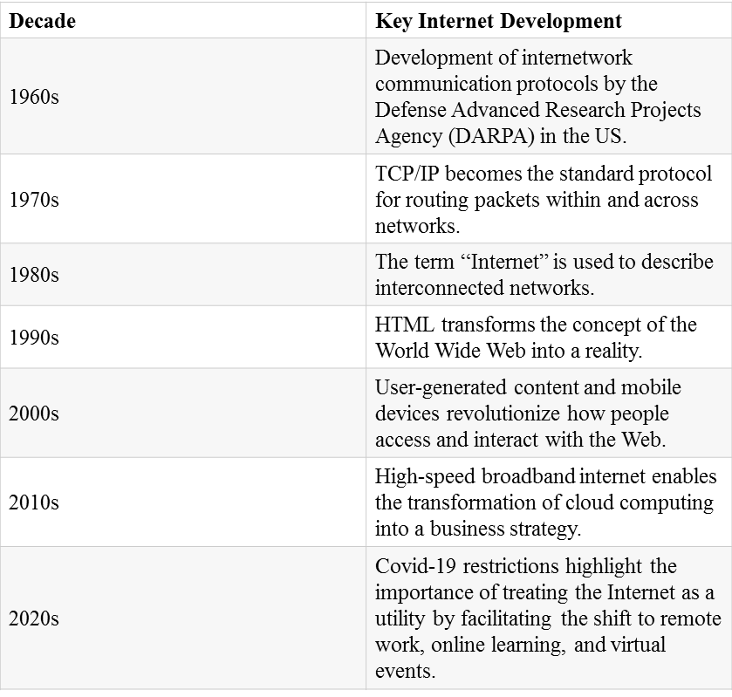

Slide 11
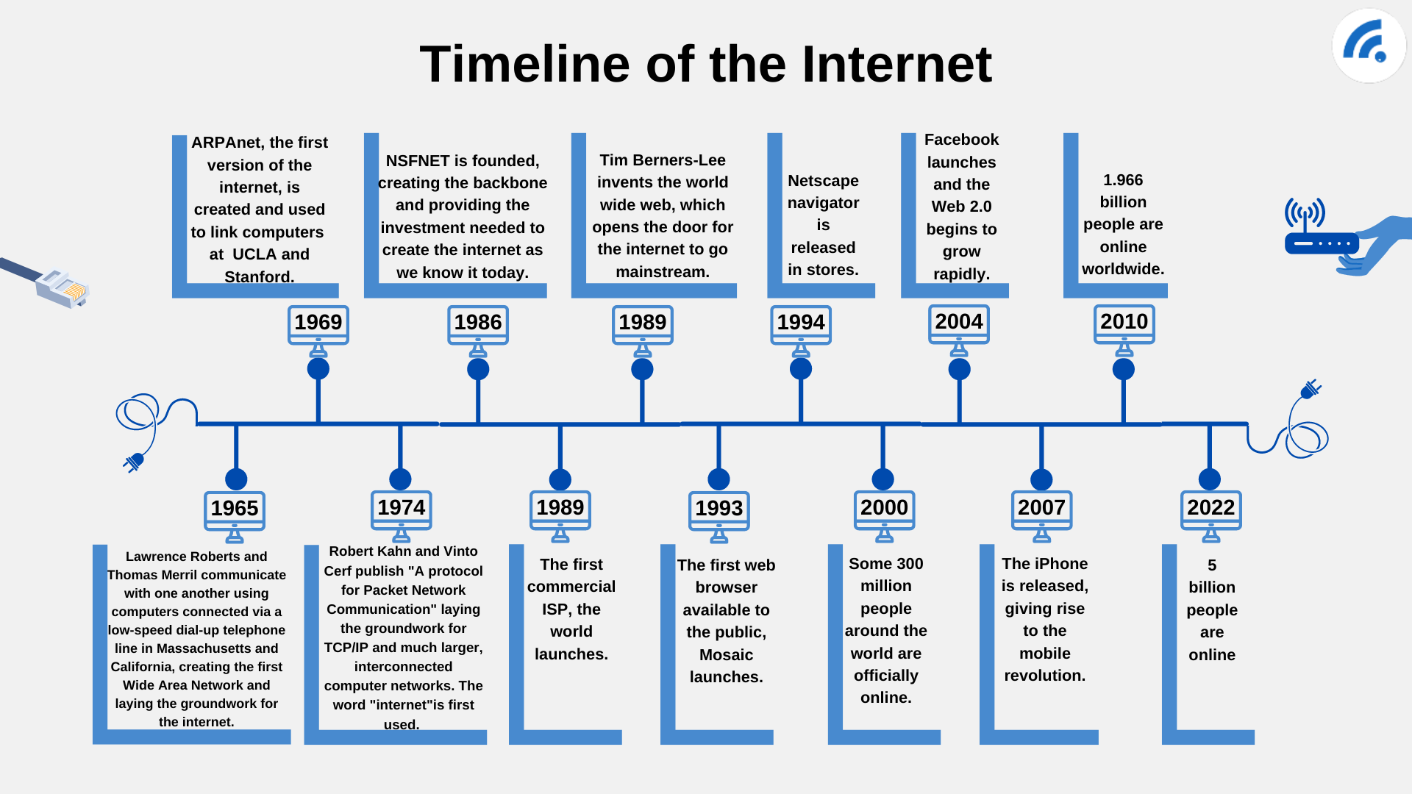
Introduction
Internet and It’s Evolution

Slide 12
Intranet
An intranet is a private network that is only accessible to authorized personnel within an organization.
Intranets are used for internal communication within organizations.
Intranets are useful for sharing information such as company policies, news, and events within the organization.
They also provide a secure platform for employees to communicate with one another, share files, and collaborate on projects
How are intranet used??
Central Repository
Collaboration
Personalization
Communication
Easy access to information
Social elements
Project management
Automation

Slide 13
Intranet
Benefits of intranet
intranets offer a secure and efficient platform for internal communication and collaboration within organizations.
They help improve productivity, streamline processes, and enhance communication among employees.
simplified records management;
streamlined tracking of requests;
a testing environment for new ideas before they are implemented on a company's webpage;
improved corporate culture that focuses on employees and encourages participation and interaction; and
a favorable return on investment from low implementation and operating costs.

Slide 14
Intranet
Disadvantages
Low user participation rates can result in a lack of the content, communications and documents needed to make the intranet beneficial.
The high cost of personnel leads to inadequate support for intranet users. As a result, when software bugs or other issues arise, problems are not resolved quickly.
The network must be managed, with regular inspections and maintenance checks to ensure it is running properly and content is fresh and relevant.
A lack of proper ownership or ownership being distributed among groups complicates network responsibilities and management.
A lack of mobile device and remote support creates problems, including limiting the ability of remote workers to access information on the intranet.

Slide 15
Extranet
Extranet is an internet that grants access to those outside of an organization to certain information and applications.
Third parties such as customers, vendors and partners are given access to certain parts of the organizations intranet.

Slide 16
World Wide Web
WWW is a system of interlinked hypertext documents accessed via the Internet.
The World Wide Web, or simply Web, is a way of accessing information over the medium of the Internet.
It is an information-sharing model that is built on top of the Internet.
The Web, was invented by British computer scientist Tim Berners-Lee in 1989 while working at CERN, the European Organization for Nuclear Research.
It was originally designed as a way for researchers to share information across different computer systems. However, it quickly evolved into a global network of interconnected documents and resources accessible through the internet.

Slide 17
World Wide Web
The Web uses the HTTP protocol, only one of the languages spoken over the Internet, to transmit data.
Web services, which use HTTP to allow applications to communicate in order to exchange business logic, use the Web to share information.
The Web also utilizes browsers, such as Internet Explorer or Firefox, Chrome and so on to access Web documents called Web pages that are linked to each other via hyperlinks.
Web documents also contain graphics, sounds, text and video.

Slide 18
Hypertext
Hypertext is a technology that allows for non-linear information retrieval by linking text, images, and other media together in a web-like structure.
It enables users to navigate between related pieces of information by clicking on hyperlinks embedded within the content.
In www, links can go not only one document to another, but also from one computer to another.

Slide 19
World Wide Web Consortium
.

Slide 20
Web Page
.

Slide 21
Web Site
.

Slide 22
Static Website
.

Slide 23
Dynamic Website
.

Slide 24
Domain Names, DNS, URLs
.

Slide 25
Static Web Pages
Static web pages are HTML documents that remain the same for all users.
They are easy to create and require no server-side processing.
However, they lack interactivity and cannot be personalized for individual users.
Examples of static web pages include company websites and online brochures.

Slide 26
Dynamic Web Pages
Dynamic web pages are generated in real-time by a server in response to user requests.
They can be customized based on user input and can display content from databases or other sources.
This makes them more interactive and engaging for users.
Examples of dynamic web pages include social media platforms and e-commerce websites.

Slide 27
Web Clients
Web clients are software applications that allow users to access and interact with web servers.
There are several types of web clients, including web browsers, mobile apps, and command-line tools.
Each type of web client has its own unique features and capabilities.
Web browsers are the most common type of web client and are used by millions of people around the world. They allow users to view web pages, download files, and interact with web-based applications.
Mobile apps are another type of web client that are designed specifically for use on smartphones and tablets. These apps often provide a more streamlined user experience and can take advantage of the unique features of mobile devices, such as touchscreens and cameras.
Command-line tools are text-based programs that allow developers to interact with web servers using a command-line interface.

Slide 28
Web Servers
Web servers are software applications that handle HTTP requests from clients and respond with HTML pages or other web content.
There are different types of web servers, such as Apache, Nginx, and Microsoft IIS.
They have varying functions and capabilities, but their main purpose is to host and manage websites and web applications.

Slide 29
Client Server Computing
A model of computing in which powerful personal computers are connected in a network together with one or more servers
Client is a powerful personal computer that is part of a network; service requester
Server is a networked computer dedicated to common functions that the client computers on the network need; service provider
Web is based on client/server technology. Web servers are included as part of a larger package of internet and intranet related programs for serving e-mail, downloading requests for FTP files and building and publishing web pages.
Typically the e-commerce customer is the client and the business is the server. In the client/ server model single machine can be both client and the server
The client/ server model utilizes a database server in which RDBMS user queries can be answered directly by the server.

Slide 30

Client Server Computing
.

Slide 31
Client-Server Architecture
Single-Tier Architecture
Single-tier architecture, also known as monolithic architecture, is a client-server model where all the layers of an application are combined into a single executable file or process.
This means that the user interface, business logic, and data storage all reside on the same machine.
Advantages
Its simplicity and ease of development, as well as its ability to handle small applications with low traffic.
Disadvantages
It can become difficult to maintain and scale as the application grows, and it may not be suitable for applications with high traffic or complex functionality.

Slide 32
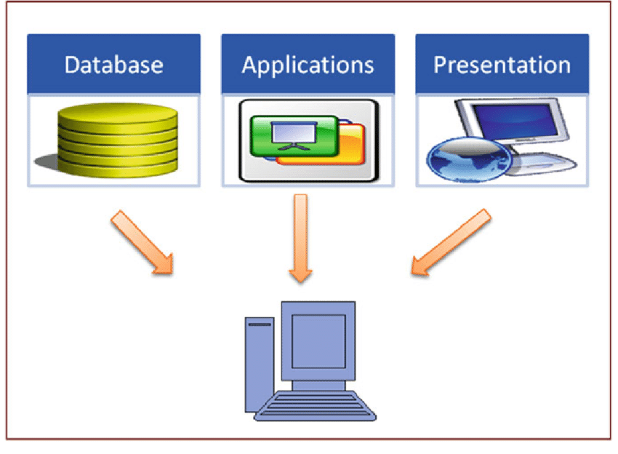
Single tier architecture

Slide 33
Client-Server Architecture
Two-Tier Architecture
Two-tier architecture is a client-server architecture where the presentation layer and data storage layer are separated.
The presentation layer, also known as the client tier, interacts with the end-user while the data storage layer, also known as the server tier, manages the data.
This separation of concerns allows for better scalability and performance in client-server applications.
Advantages
It enables faster response times because the client can process some of the application logic locally, reducing the amount of data that needs to be transmitted over the network.
Additionally, it allows for easier maintenance and upgrades since changes can be made to one tier without affecting the other.
Two-tier architecture is commonly used in applications such as e-commerce websites, online banking systems, and reservation systems.

Slide 34
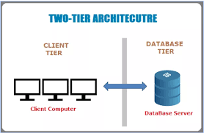
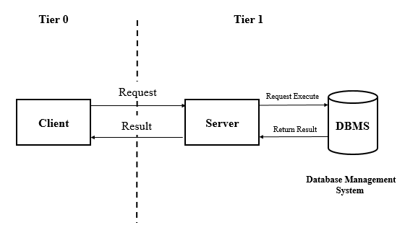
Two tier architecture

Slide 35
Client-Server Architecture
Multi-Tier Architecture
Multi-tier architecture, also known as n-tier architecture, is a client-server architecture that divides an application into three or more logical tiers.
Each tier has a specific function and communicates with the other tiers through well-defined interfaces.
The benefits of multi-tier architecture include improved scalability, flexibility, and maintainability.
By separating the presentation, business logic, and data storage layers, developers can make changes to one layer without affecting the others.
This makes it easier to add new features, fix bugs, and optimize performance.

Slide 36
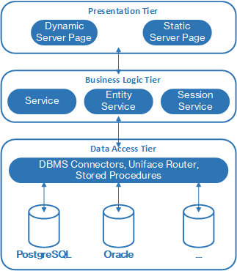
Multi-tier Architecture

Slide 37
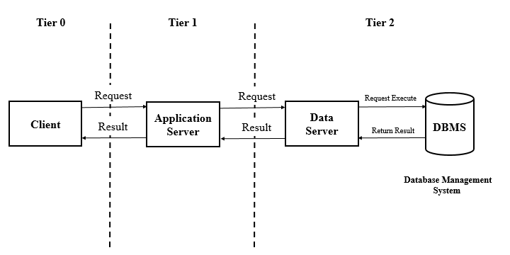
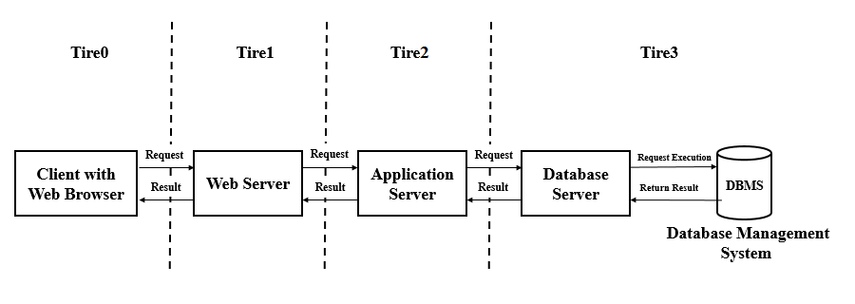

Slide 38
HTTP
HTTP (Hypertext Transfer Protocol) is an application layer protocol that facilitates communication between web servers and clients.
It is the foundation of data communication on the World Wide Web.
HTTP allows for the transfer of various types of data, including text, images, videos, and audio files.
Without it, we wouldn't be able to access websites or communicate with servers.

Slide 39
HTTP REQUEST
An HTTP is a message sent by a client to a web server, requesting information or resources hosted on that server.
The server process the request and sends the HTTP response back to the client.
It consist of :
Request Method: get, post, put, delete
Request URL
Request headers
Request body

Slide 40
HTTP RESPONSE
The HTTP response consists of three main components: the status line, headers, and body.
The status line contains a three-digit code that indicates whether the request was successful or not, along with a brief description of the status.
For example, a 200 status code means the request was successful, while a 404 status code means the requested resource could not be found.
Headers provide additional information about the response, such as the content type and length.
They can also include cookies, which are small pieces of data sent from the server and stored on the client's computer.
The body of the response contains the actual data being sent back to the client, such as HTML, JSON, or an image.

Slide 41
URL
A URL, or Uniform Resource Locator, is a string of characters that identifies a web resource.
It consists of several parts, including the scheme, host, path, and query parameters.
The scheme indicates the protocol used to access the resource, such as HTTP or HTTPS.
The host specifies the domain name or IP address of the server hosting the resource.
The path specifies the location of the resource on the server,
The query parameters provide additional information about the request.
https://www.collegenote.net/curriculum/web-technology-csit/84/468/

Slide 42
Client Side Scripting
Client-side scripting generally refers to writing the class of computer programs(script) on the web that are executed at client side, by the user’s web browser, instead of server side(on web server).
Usually scripts are embedded in the HTML page itself.
Client side Scripting technologies: JavaScript, VBScript, Jscript, Java Applets etc.
Client-side scripting have greater access to the information and functions available on the user’s browser.

Slide 43
Client Side Scripting
Upon the request, the necessary files are sent to the user’s computer by the web server(servers) on which they reside.
The web browser executes the script, then displays the document, including any visible output from the script.
Client-side scripts may also contain instructions for the browser to follow in response to certain user actions(eg. Clicking button, scrolling mouse)
Such instructions can be followed without further communication with the server.

Slide 44
Server Side Scripting
Writing applications or programs that are executed by the server at run-time to process client input or generate document in response to client request.
It consists the directives embedded in web pages for server to process before passing to requester.
Have greater access to the information and functions available on the server.
Usually used to provide interactive sites that interface to databases or other data stores.

Slide 45
Client Side Scripting
Primary advantages of server side scripting is the ability to highly customize the response based on the user’s requirements, access rights, or querying to data stores.
Examples: PHP, JSP, ASP, ...

Slide 46
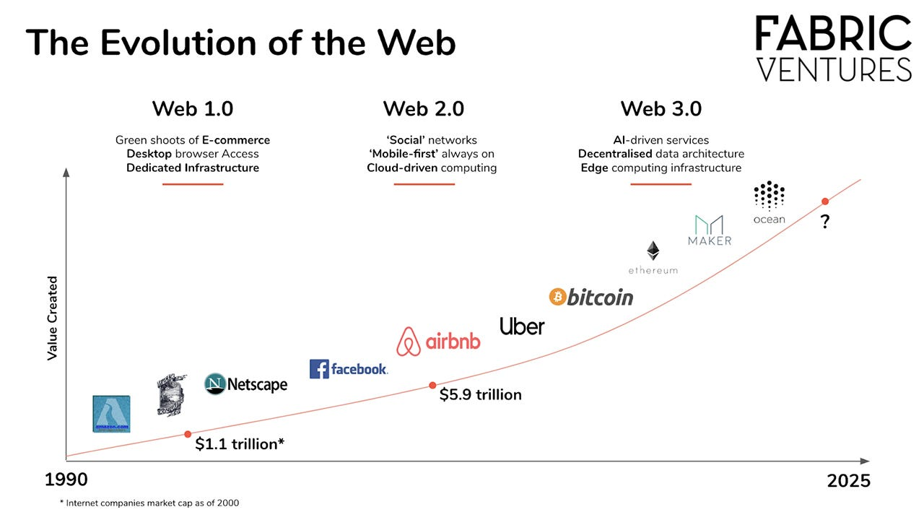
Evolution of Web

Slide 47
Web 1.0
Web 1.0 refers to the first stage of the World Wide Web evolution.(first generation)
Web 1.0 is content delivery network(CDN) that enables the showcase of the piece of information on the websites.
It can be used as personal websites. It costs the user as per pages viewed.
It has directories that enables users to retrieve a particular piece of information
Era of Web 1.0 was roughly 1991-2004

Slide 48
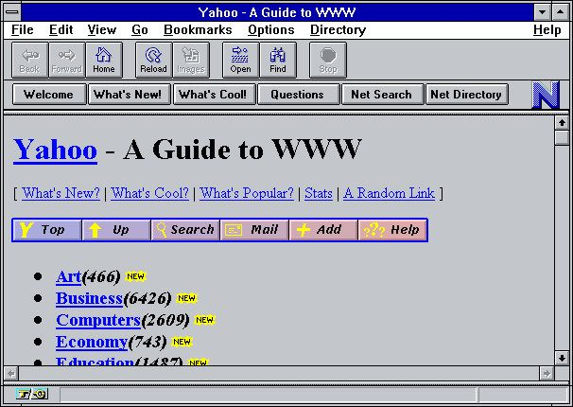
Web 1.0
Elements that define Web 1.0 can include:
Static pages
HTML 3.2 elements such as frames and tables
HTML forms sent via email
Content from the server’s file system, rather than a relational database management system
GIF buttons and graphics

Slide 49
Web 2.0
The term Web 2.0 is associated with web applications that facilitate participatory information sharing, interoperability, user-centered design, and collaboration on the World Wide Web.
A Web 2.0 site allows users to interact and collaborate with each other in a social media dialogue as creators of user-generated content in a virtual community, in contrast to websites where users are limited to the passive viewing of content that was created for them.

Slide 50
Web 2.0
Web 2.0 become famous due to the first web 2.0 conference(Web 2.0 Summit 2004) held by Tim O’Reilly and Dale Dougherty.
The term was coined by Darcy DiNucci in 1999
Enhanced version of Web 1.0
Main technologies: AJAX and JavaScript frameworks.

Slide 51
Web 3.0
Web 3.0 is a term that refers to the potential future evolution of the world wide web beyond its current state.
It is next phase of web following earlier web 1.0(static web pages) and Web 2.0(interactive and user generated content)
It is expected to introduce several new features and capabilities that could revolutionize how we use and interact with the internet

Slide 52
Web 3.0
Some elements that define Web 3.0
Semantic Web
AI and Machine Learning
3-D Graphics
Connectivity
Ubiquity(multiple access)
DLT and Smart Contacts

Slide 53
Thank You!!!!!!!!!!

Slide 54
Assignment
Differentiate between HTTP and FTP
Explain the SMTP with example.
Explain the functions of web caches.

